Slide 1
Web Security
Sean Madden

Slide 2
The Interblag!
It’s a series of tubes
These tubes are glass
Anybody can see and modify the contents
SECURITY!

Slide 3
HTTP
HyperText Transport Protocol
Two main request mechanisms
GET
POST

Slide 4
HTTP GET
http://www.google.com/translate
Opens connection to google.com
Transmits :
GET /translate HTTP/1.1<cr><nl>
Host: www.google.com<cr><nl>

Slide 5
HTTP POST
http://www.google.com/translate
Opens connection to google.com
Transmits:
POST /translate HTTP/1.1<cr><nl>
<cr><nl>
q=thisisthetestdata

Slide 6
INJECTIONS!
Structured Query Language (SQL)
Cross-Site Scripting (XSS)
Headers

Slide 7
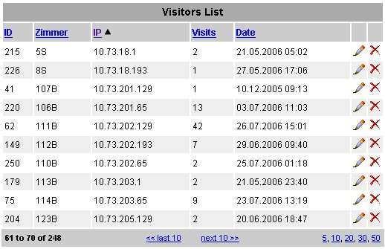
Relational Databases

Slide 8
SQL
“select {columns} from {table} where {criteria};”
“delete from {table} where {criteria};”
“delete table {table};”

Slide 9
SQL Injection
"SELECT * FROM users WHERE
name = '" + userName + "';"

Slide 10
INJECT
a' or 't'='t
Result:
SELECT * FROM users WHERE name = 'a' OR 't'='t';

Slide 11
Malicious Intent
a';DROP TABLE users; SELECT * FROM userinfo WHERE 't' = 't
SELECT * FROM users WHERE name = 'a';DROP TABLE users; SELECT * FROM userinfo WHERE 't' = 't';

Slide 12
Firefox Addons for Manipulation
Web Developer Toolbar
FireBug
SQL Inject Me

